Slide 1
Data Tech and the GHA

Slide 2
Overview
Day-to-day issues and applications of tech to solve them
File Manipulation
“Big” Data Manipulation
Data Scraping
Analysis & Visualization

Slide 3
File Manipulation
“I need one spreadsheet per country, based on one large spreadsheet.” (Writing)
“I need to rename every xlsx in this folder.” (Renaming)
“I need to download a large file from online, unzip it” (Downloading)

Slide 4
File Manipulation (Writing)
R Scripts
data <- read.csv(“data.csv”)
countries <- unique(data$country)
for(i in 1:length(countries){
sub <- subset(data,country==countries[i])
write.csv(sub,paste0(countries[i],”.csv”))}
Python
NodeJS

Slide 5
File Manipulation (Renaming)
R Scripts
wd <- "C:/git/digital-platform/latest-year“
filenames <- list.files(wd,pattern="*.csv", full.names=TRUE)
for(i in 1:length(filenames)){
bname <- tolower(basename(filenames[i]))
file.rename(filenames[i],bname)}
Python
NodeJS

Slide 6
File Manipulation (Downloading)
R Scripts
zipname <-“http://data.gdeltproject.org/events/20150819.zip"
zip <- tempfile()
download.file(zipname,zip)
unzip(zip)
Moderately useful now. Imagine the utility when we can dynamically replace “20150819” in the URL and download files for the last 5 days. Or 500.

Slide 7
“Big” Data Manipulation
Comparisons
Twitter (58 million Tweets per day)
Facebook (3 million messages every half hour)
AidData (300 thousand records per year)
DI (???)
Reading speed
Experiment using CSVs and XLSX.
Starting at 10 rows with 10 variables, and increasing the number of rows by the power of 10 each time.
Writing XLSX failed after 1 million rows.
Writing CSVs failed after 100 million rows
File size could not be stored in memory

Slide 8
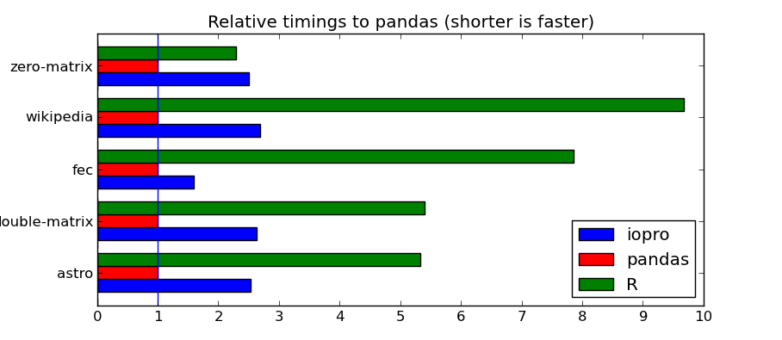
“Big” Data Manipulation
Better solutions?
Python
Pandas
Streaming data
OpenRefine
R will probably suffice for our purposes
Easy to read, subset, transform, reshape, and write
Source: wesmckinney.com

Slide 9
Data Scraping
Where is data the least accessible?
Websites (lots of different ones)
PDFs
How can we access it?
Webscraping
PDF scraping
No need to reinvent the wheel

Slide 10
Data Scraping
Some providers make it easy for us
OECD, WB, and FTS provide different versions of an API (Application Programming Interface)
This allows us to easily hook R into their databases
Some providers make it difficult
Practical example, the CERF (http://www.unocha.org/cerf/cerf-worldwide/allocations-country/2015)

Slide 11
Analysis and Visualization
Look-up table alternative (merge)
Precise, logical matching along multiple dimensions
Pivot table alternative (ddply)
Iteration based data summation
Know exactly what calculation leads to the final number
Less graphical, more powerful

Slide 12
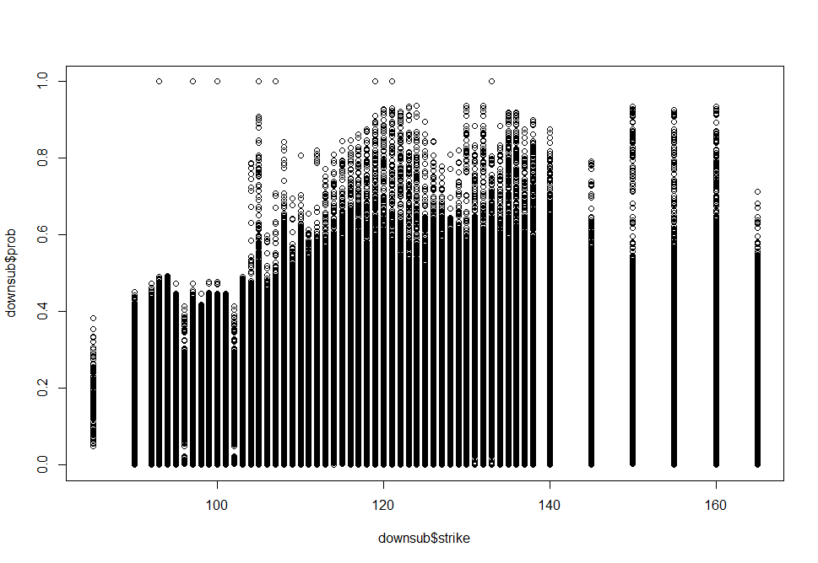
Analysis and Visualization
Too many points to see a trend?

Slide 13
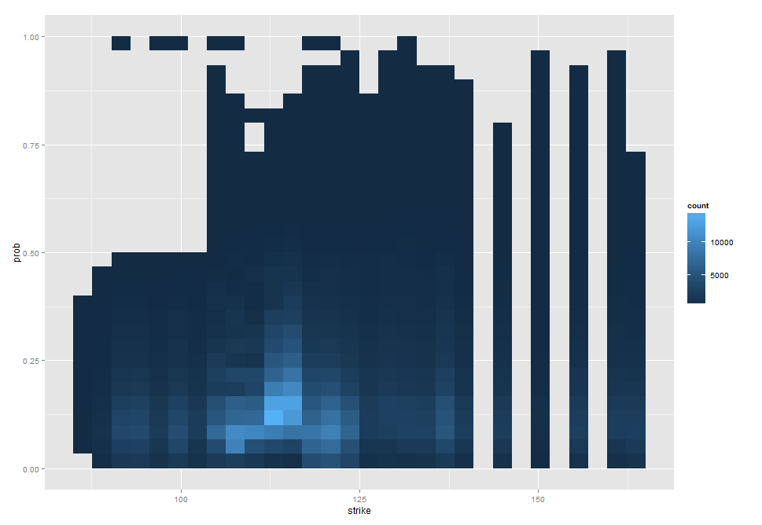
Analysis and Visualization
Try ggplot2’s 2d bin!

Slide 14
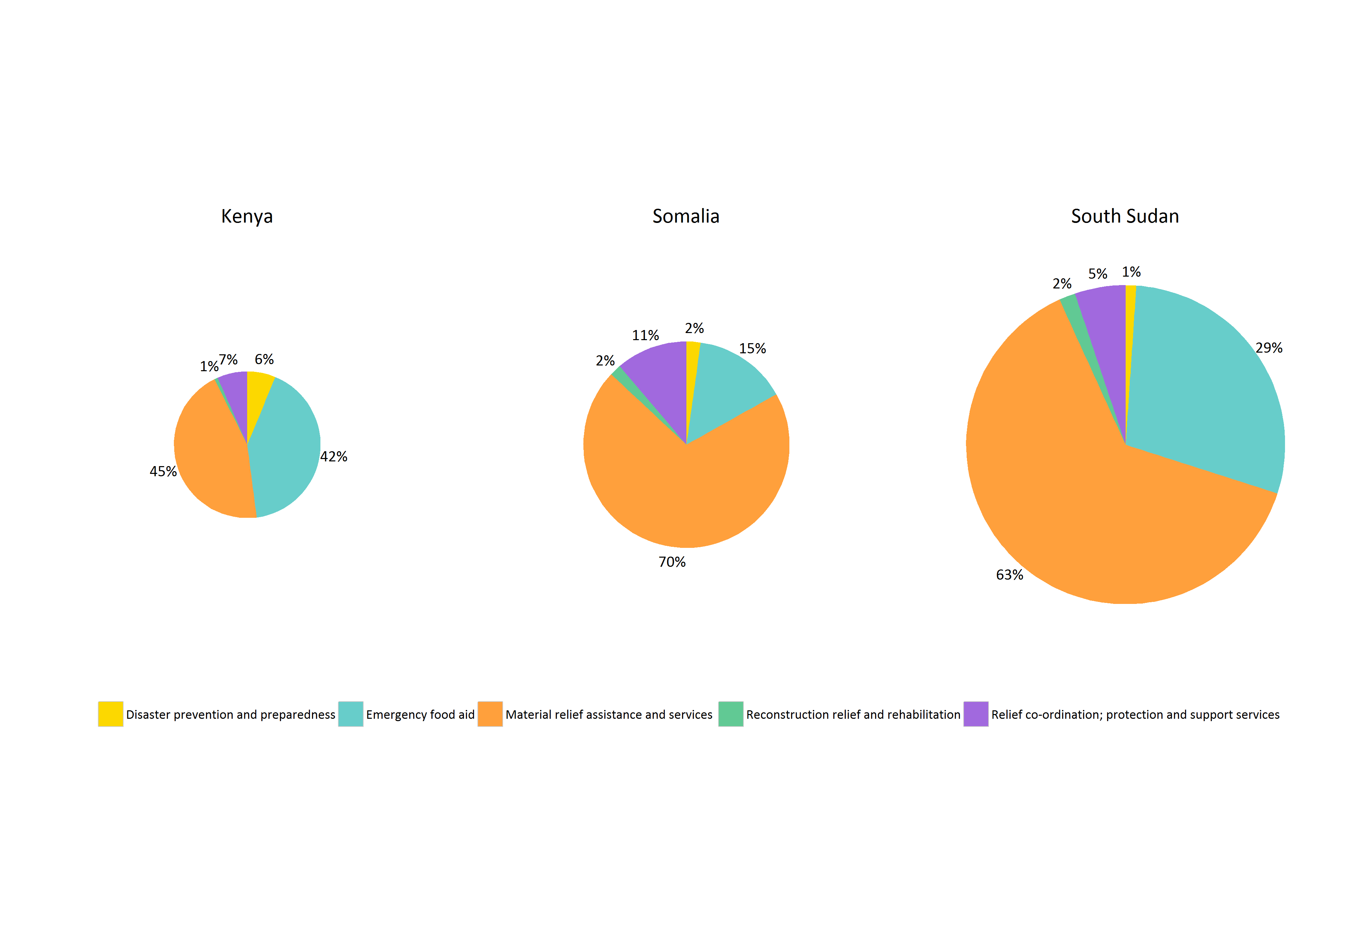
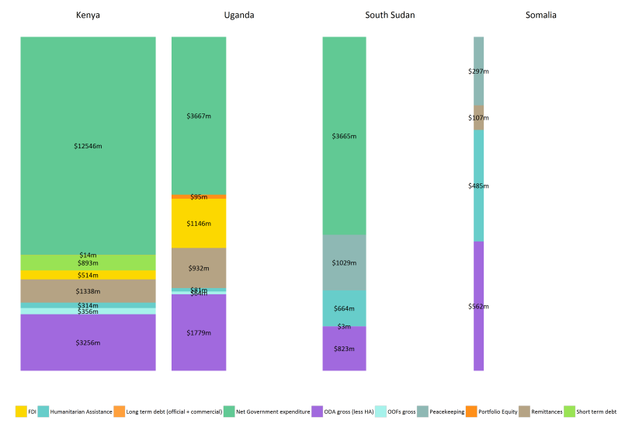
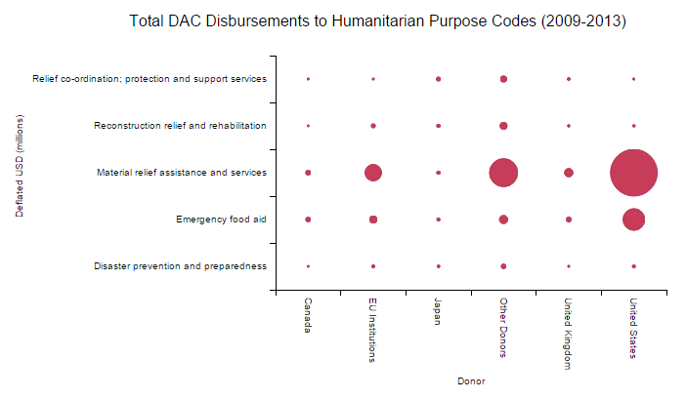
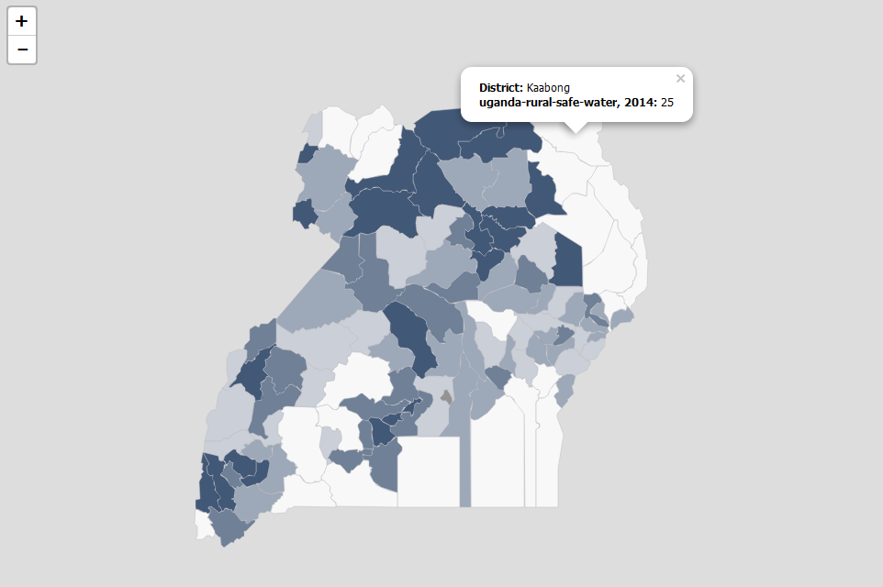
Analysis and Visualization

Slide 15
Final Points
What does R do for us?
Efficiency
Accountability
Reproducibility
Bottom line
This is to make your life easier
Adopt the techniques that do, don’t bother with the techniques that don’t

